Slide 1


Banking University
Bootcamp - Intro to AI Programming with Python

Slide 2

What is important to get
Machine learning has evolved like a growing mind: starting with basic rules, learning from mistakes, and gradually mastering complex ideas.
Understanding this journey makes the magic of AI feel less like magic and more like a story of progress.
To grasp complex ideas, we must first understand the basic rules

Slide 3
Content
Gradient descent
Tree based algorithms
Neural Networks
Natural Language Processing
Sentiment analysis model
Text autocomplete model

Slide 4
Gradient descent - black-box tool
The most popular learning method in Machine Learning
Used in many algorithms from classical ML algorithms to deep neural networks
Many people use it but do not understand it
Gradient descent - a way to minimize an objective function

Slide 5
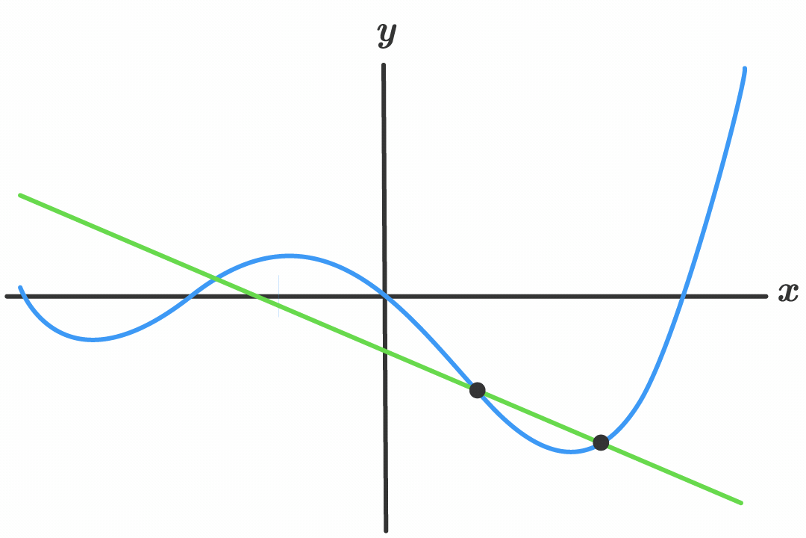
What is a derivative?
The derivative of a function gives us a measure of how the function changes with respect to its independent variable (usually x).
Notes:
Derivata unei funcții la un punct ne spune cât de repede (și în ce direcție) se modifică valoarea funcției când schimbăm puțin variabila.
Intuiție vizuală: Dacă ai o curbă (graficul unei funcții), derivata într-un punct = pantă/“înclinarea”/“viteza de urcare/coborâre” în acel punct.

Slide 6
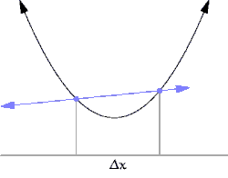
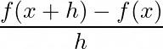
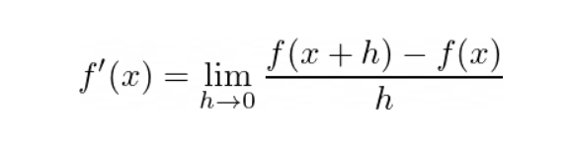
A visual intuition
Consider the curve of a function f(x). Choose two points on it: x and x + h. The slope between these two points can be described by the mean slope.
Here, h is the distance between the two points in the x-direction. As we reduce h, we bring the two points closer and closer together, and the average slope converges to a single value. This value, in the limit where h → 0, is the derivative.
Source: https://medium.com/@julioaraujo.guel/derivatives-the-heart-of-change-46bbbd8fad97

Slide 7

Speed - Acceleration
T - Time (measured in seconds)
V - speed (km/h * 10)
Interval 0 - 3s:
1.5s - acceleration
1.5s - break
V: [0 : 3] -> [0 : 9]
V(T) = 4T(3 - T)

Slide 8
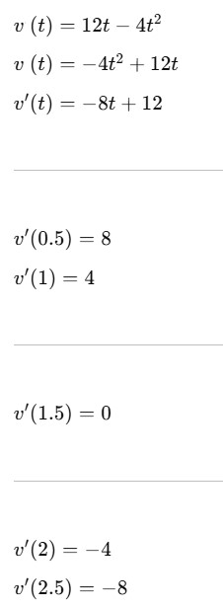
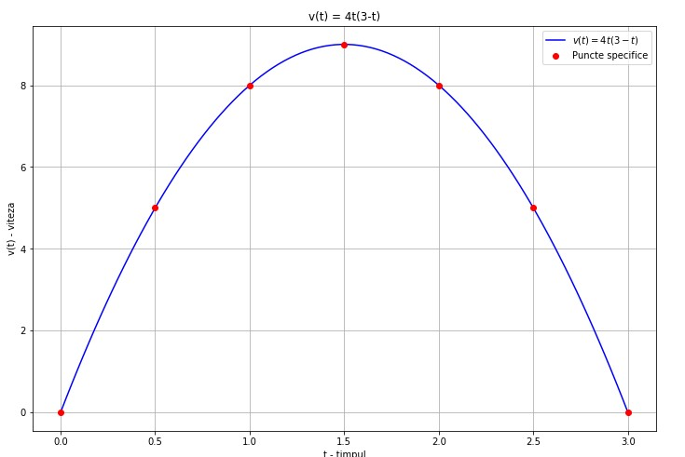
Example: v(t) = 4t(3 - t)

Slide 9
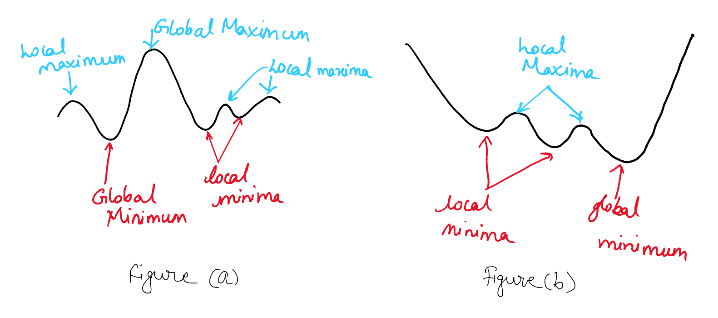
Gradient descent
As the name suggests minimum is the lowest value in a set and maximum is the highest value. Global means it is true for the entire set and local means it is true in some vicinity. A function can have multiple local maxima and minima. However there can be only one global maximum as well as minimum.
Source: https://towardsdatascience.com/gradient-descent-unraveled-3274c895d12d-2/

Slide 10
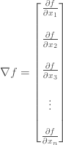
What is a gradient?
Gradient: In vector calculus, the gradient is the multi-variable generalization of the derivative.
It packages all the partial derivatives information into a vector.

Slide 11
Gradient descent weights
Gradient descent models use weights
X - feature
Y - target
A - weight
X * a = Y
A - “magic variable”
X
Y

Slide 12
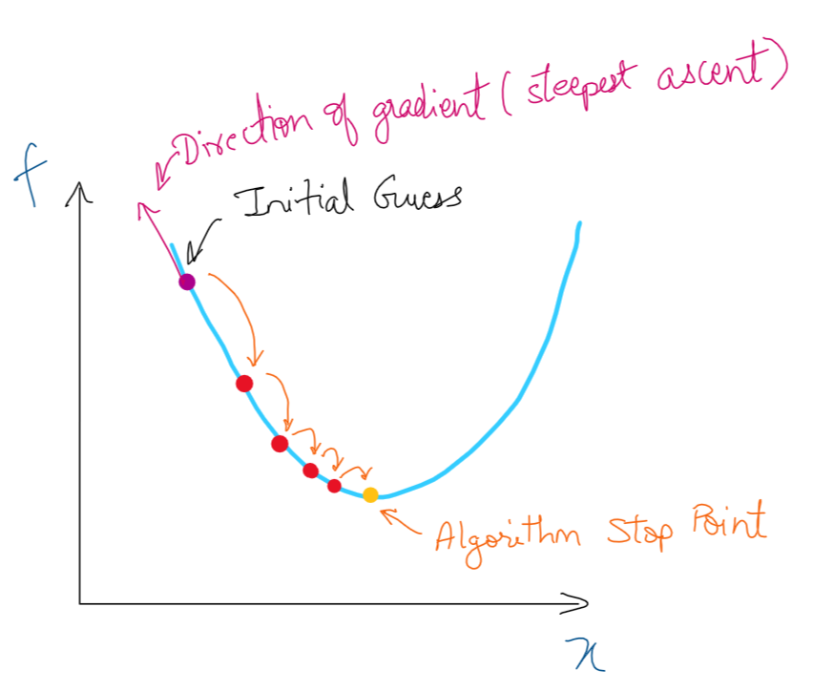
Gradient descent steps
Guess a point (randomly or through some technique).
Choose a step size which in deep learning is called the learning rate ρ and is also one of the most important hyper-parameter in deep learning.
Calculate the gradient of the function
Move in the opposite direction by subtracting this from the initial guess. This is because we want to descend and gradient gives you steepest ascent direction.
Repeat steps 3 and 4 for n times or until a stop criterion is reached

Slide 13
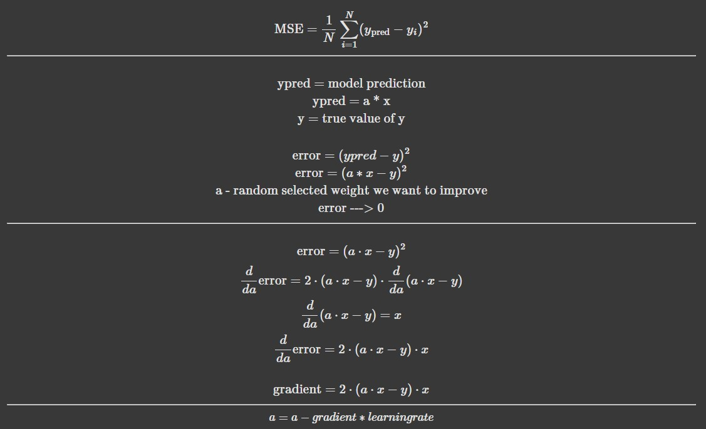
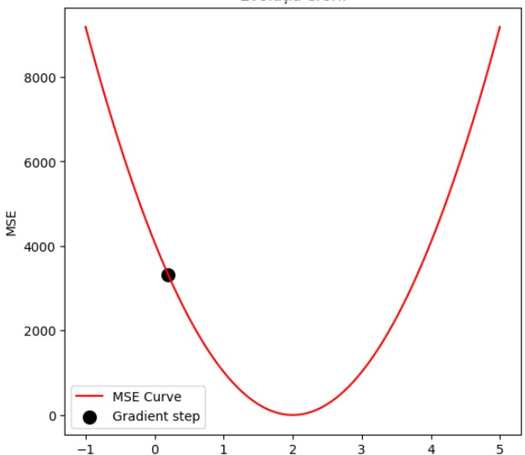
Learning step
(Ypred - Y)**2

Slide 14
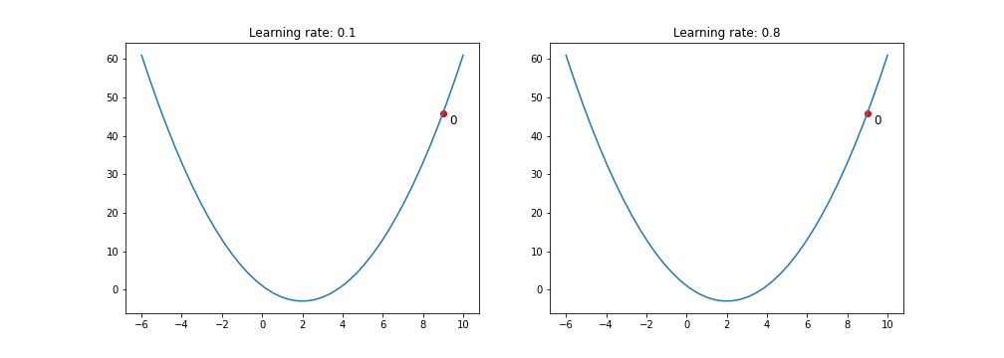
https://medium.com/data-science/gradient-descent-algorithm-a-deep-dive-cf04e8115f21

Slide 15
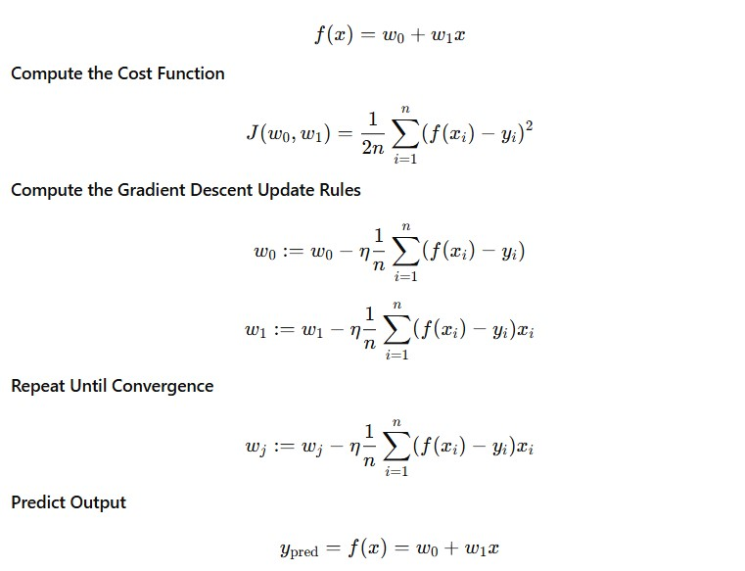
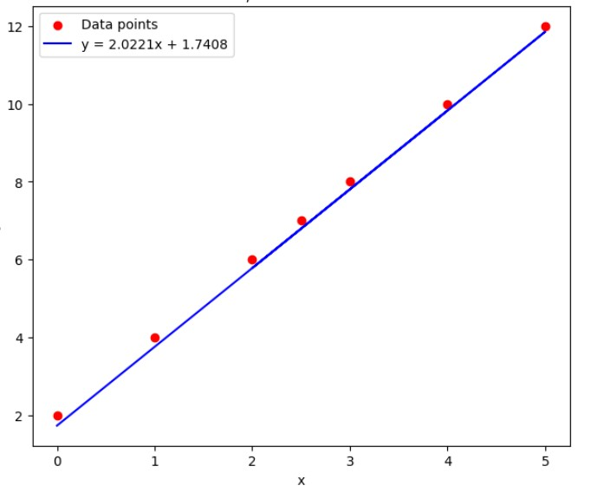
Linear regression

Slide 16
Q1. Gradient descent variants
Which method is better?
SGD - one point per step
Batch GD - all points per step
Variant | Description | Time | Memory
Stochastic GD | One point | ? | ?
Batch GD | All points | ? | ?

Slide 17
Gradient descent variants
Variant | Description | Time | Memory
Stochastic GD | One point | Slow | Low
Batch GD | All points | Fast | High

Slide 18
Gradient descent variants
Variant | Description | Time | Memory
Stochastic GD | One point | Slow | Low
Batch GD | All points | Fast | High
Variant | Description | Time | Memory
Stochastic GD | One point | Slow | Low
Batch GD | All points | Fast | High
Mini-Batch GD | Batches | Medium | Medium
Notes:
There isn't a universally "better" method; it depends on the dataset size, computational resources, and specific problem.
For very large datasets where memory is a constraint or you want faster initial convergence, SGD (or more commonly, its variant Mini-Batch Gradient Descent) is often preferred.
For smaller datasets or when you need a very stable and precise convergence, Batch GD might be suitable.

Slide 19
Q2. Starting point
If we start the gradient from 2 random points both will go in the same point?

Slide 20
Q2. Starting point
If we start the gradient from 2 random points both will go in the same point?

Slide 21
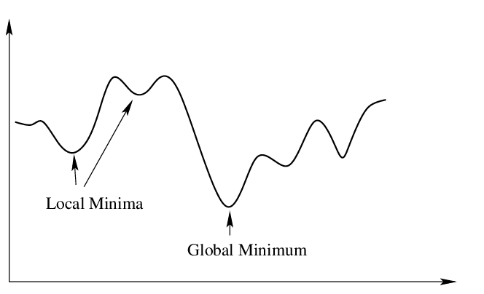
Q2. Starting point
If we start the gradient from 2 random points both will go in the same point?
Notes:
"Nu neapărat. Depinde de forma funcției.
Dacă funcția este convexă (cum ar fi parabola din graficul din stânga, care are un singur minim global), atunci da, gradient descent-ul va converge în același punct (minimul global) indiferent de punctul de pornire (presupunând o rată de învățare adecvată).
Dacă funcția este non-convexă (cum ar fi graficul din dreapta, care are mai multe minime locale și un minim global), atunci nu. Punctele de pornire diferite pot duce la convergența în minime locale diferite sau chiar în minimul global, dar nu este garantat că vor ajunge în același punct."

Slide 22
Q3. Will GD conduct to ZERO error?
Notes:
While Gradient Descent (GD) is a powerful optimization algorithm, it's highly unlikely it will lead to zero error in real-world scenarios. Here's why:
Noise in Data: Real-world data is inherently noisy. Even if your model perfectly captures the underlying relationship, random fluctuations in the data will prevent the error from reaching absolute zero.
Model Misspecification: Your chosen model might not be complex enough to perfectly represent the true underlying function that generated the data. There will always be some irreducible error due to the limitations of your model.
Local Minima: For non-convex cost functions, GD can get stuck in a local minimum, which is not necessarily the global minimum (the point of lowest possible error).
Learning Rate: The learning rate determines the step size GD takes. If it's too large, you might overshoot the minimum. If it's too small, convergence will be very slow. Finding the perfect learning rate is challenging.
Convergence Criteria: GD typically stops when the change in error between iterations is below a certain small threshold, not necessarily when the error is exactly zero.
Numerical Precision: Computers have finite precision, which can introduce tiny errors in calculations, preventing an absolute zero error.
Instead of aiming for zero error, the goal with GD (and machine learning in general) is to minimize the error as much as possible given the data, model, and computational constraints, and to find a solution that generalizes well to unseen data.

Slide 23
Q4. We always need global minimum?

Slide 24
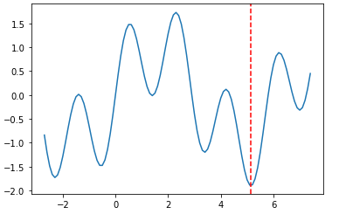
Q4. We always need global minimum?
Notes:
Why we want the global minimum: The global minimum represents the absolute best set of parameters for our model, given our chosen cost function and training data. It's the point where the model's error is theoretically minimized. Achieving it means our model is performing as well as it possibly can under those conditions.
Why we don't always need it:
Good Enough is Often Enough: In many practical applications, finding a "good enough" local minimum that yields satisfactory performance is perfectly acceptable. The incremental gain from moving from a very good local minimum to the absolute global minimum might not be worth the additional computational cost or complexity.
Computational Cost: For very complex models and datasets, exhaustively searching for the global minimum can be computationally prohibitive or even impossible in a reasonable amount of time.
Overfitting: Sometimes, a model that achieves the absolute global minimum on the training data might actually be overfitting. This means it has learned the training data (including its noise) too well and might perform poorly on new, unseen data. A slightly higher error on the training set might lead to better generalization.
Why we don't always achieve it:
Non-Convexity: Many real-world machine learning problems involve non-convex cost functions. These functions have multiple "dips" or local minima. Algorithms like Gradient Descent can easily get stuck in one of these local minima, especially if the starting point is not chosen carefully.
High Dimensionality: In high-dimensional spaces (models with many parameters), the landscape of the cost function becomes incredibly complex, making it even harder to guarantee finding the global minimum.
Stochasticity: Algorithms like Stochastic Gradient Descent (SGD) introduce randomness in their updates. While this can help escape shallow local minima, it doesn't guarantee finding the global one.

Slide 25
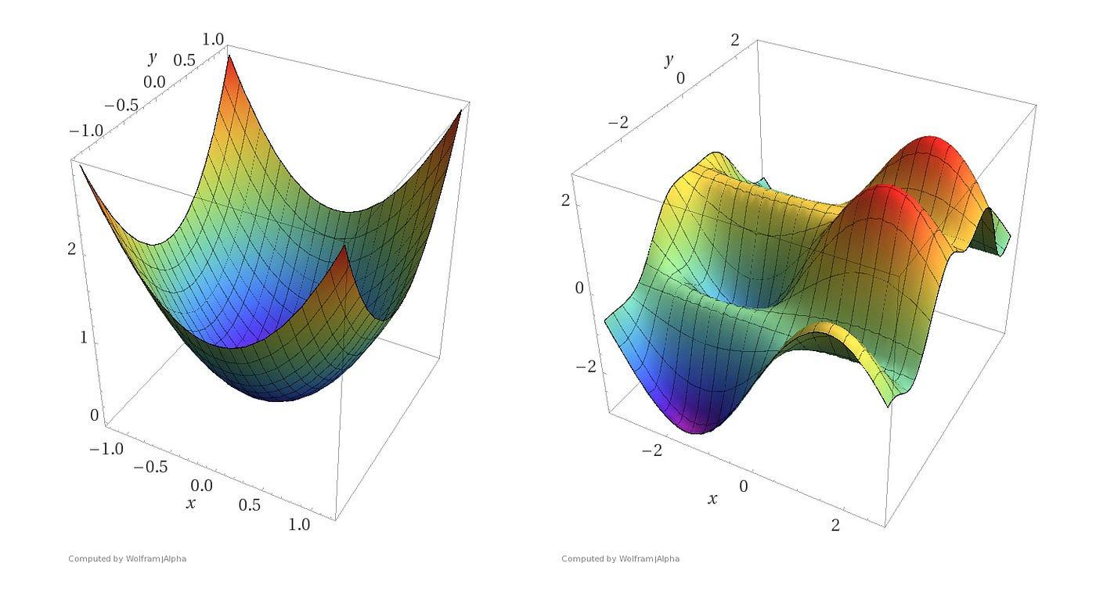
Local and global minim

Slide 26
Text features
Models works only with numeric features
How we transform text features in numeric features
Label Encoding
One Hot Encoder
TF-IDF vectorizer

Slide 27
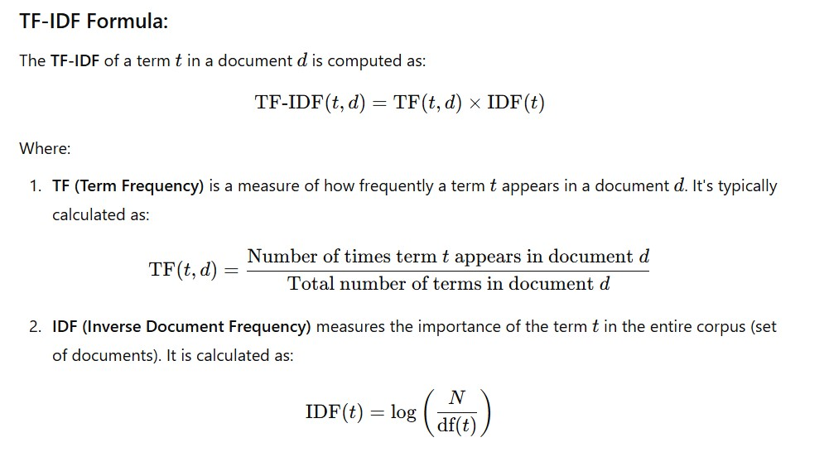
Notes:
TF IDF arata cat de important e un cuvant intr-un anumit text, fata de toate celelalte texte. Scorul e mare cand: un cuvant apare DES in textul tau (TF mare) si este rar in toate celelalte texte (mare IDF).

Slide 28
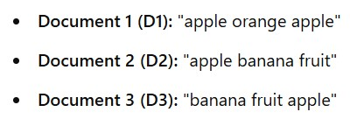
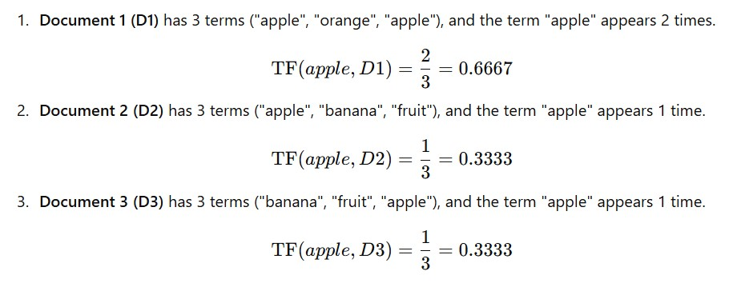
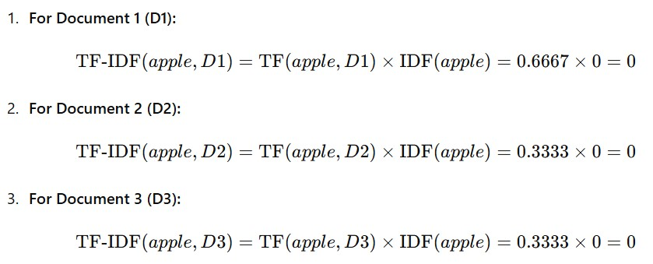
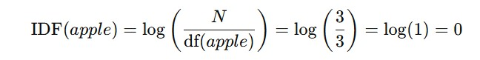

Slide 29
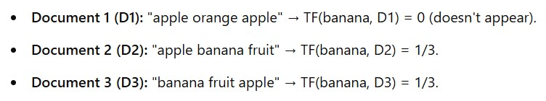
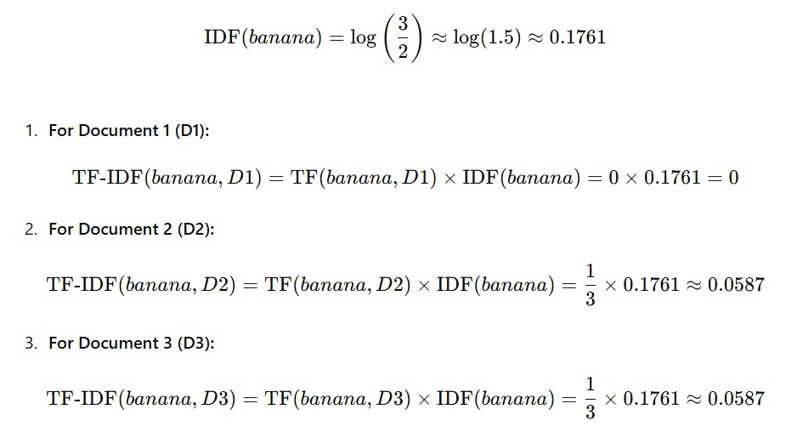

Slide 30
Output example
 | w1 | w2 | w3 | w4 | w5 | w6
D1 | 0 | 0.157 | 0.053 | 0 | 0.021 | 0.251
D2 | 0.027 | 0 | 0 | 0.058 | 0.027 | 0
D3 | 0 | 0.058 | 0.053 | 0 | 0.027 | 0.072
D4 | 0.002 | 0 | 0.157 | 0.027 | 0 | 0.157
Notes:
Q2. In terms of memory, TF-IDF can be quite demanding, especially for large corpora.
Here's a breakdown:
Sparse Matrix Representation: The core output of TF-IDF for a corpus is often represented as a sparse matrix. Each row corresponds to a document, and each column corresponds to a unique term in the vocabulary. The values in the matrix are the TF-IDF scores.
Vocabulary Size: The number of unique words (the vocabulary size) can be very large in a real-world corpus. Even after stemming/lemmatization and removing stop words, you might have hundreds of thousands or even millions of unique terms. This directly impacts the number of columns in your matrix.
Number of Documents: The number of documents also directly impacts the number of rows.
Memory Footprint Calculation:
If you have N documents and M unique terms, the full matrix would be N x M. Even if most entries are zero (which they are, making it sparse), storing the non-zero elements and their coordinates still requires significant memory.
For example, a corpus of 100,000 documents with a vocabulary of 50,000 unique terms could result in a sparse matrix that, while not requiring 100,000 * 50,000 * sizeof(float) (which would be astronomical), still needs to store the term indices, document indices, and the TF-IDF values for all non-zero entries.

Slide 31
Questions
Q1. How is TF-IDF in terms of natural language understanding?
Q2. How is TF-IDF in terms of memory?
Notes:
Q1. TF-IDF (Term Frequency-Inverse Document Frequency) is not a technique for natural language understanding (NLU) in itself. Instead, it's a statistical measure used to evaluate how important a word is to a document in a collection or corpus.
Here's why it's not NLU and what it does contribute to:
No Semantic Understanding: TF-IDF doesn't understand the meaning, context, or relationships between words. It treats words as independent tokens. For example, it wouldn't know that "apple" as a fruit and "Apple" as a company are different concepts, nor would it understand that "king" and "queen" are related.
Focus on Statistical Importance: Its primary goal is to identify words that are relevant within a specific document (high Term Frequency) but also unique to that document across the entire corpus (high Inverse Document Frequency). This helps to filter out common words (like "the," "a," "is") that appear frequently everywhere and thus carry less specific information.

Slide 32
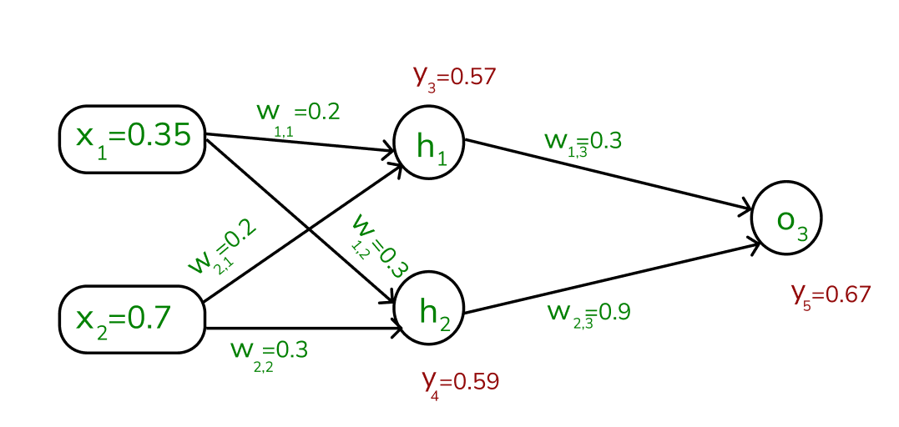
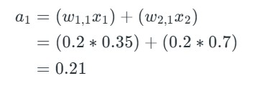
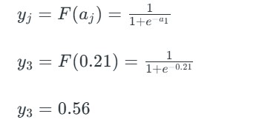
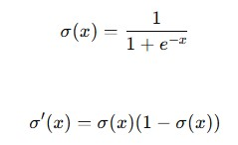
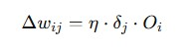
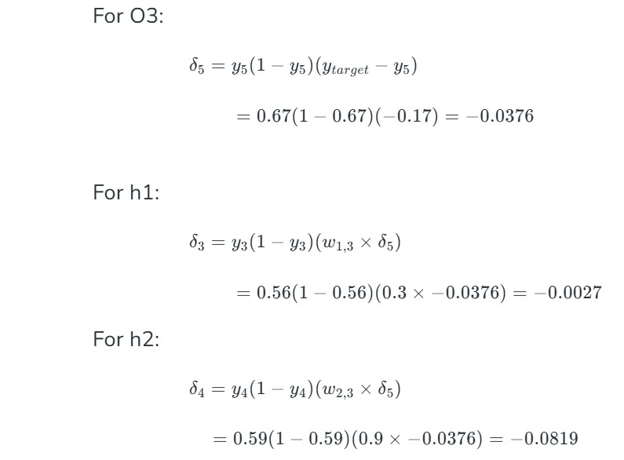
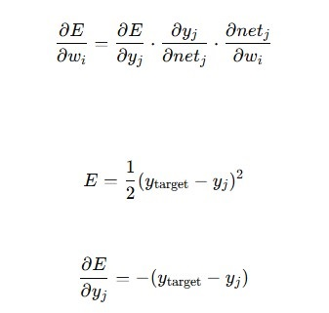
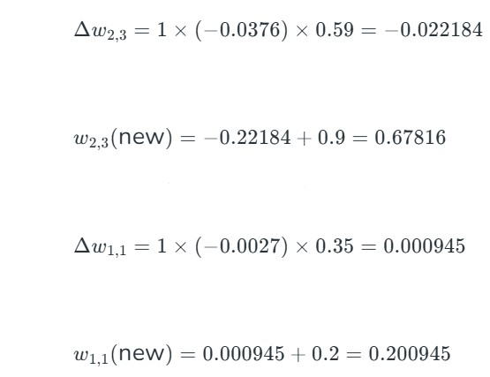
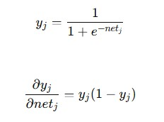
Neural Networks

Slide 33
Questions
What is the role of activation functions in hidden layers?

Slide 34
Word embeddings
A word embedding is a learned representation of a word such that the words with same meaning have similar representation.
The geometric relationship between words should reflect the semantic relationship.
The vocabulary is predefined and learned over a large corpus of text.
KING - MAN + WOMAN = QUEEN

Slide 35
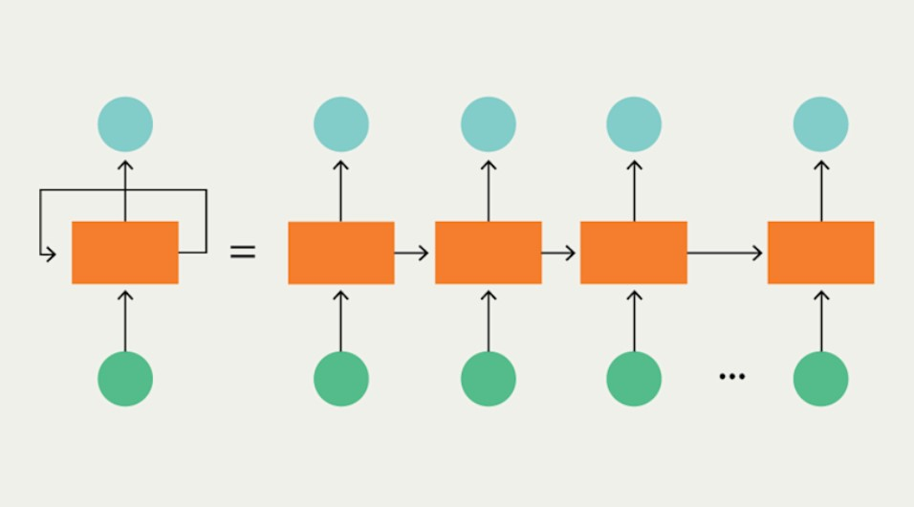
Recurrent neural networks
[dog, cat, fox]
[[0.1, 0.2, 0.3, 0.4],
[0.5, 0.6, 0.7, 0.8],
[0.9, 0.1, 0,5, 0.7]]

Slide 36
Demo
Text autocomplete
Word2Vec
RNN - LSTM
Evaluation

Slide 37
Transformers
Like the RNNs, transformers can handle distant information
RNNs struggle with long sequence data.
Transformers are not based on recurrent connections
Transformers are more efficient to implement at scale
Transformers are made up of stacks of transformer blocks, each of which is a multilayer network made by combining:
● simple linear layers
● feedforward networks
● self-attention layers
Self-attention allows a network to directly extract and use information from arbitrarily large contexts without the need to pass it through intermediate recurrent connections as in RNNs

Slide 38
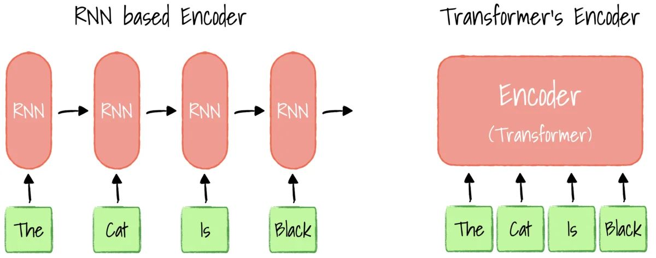
Transformers

Slide 39
Questions?

